Slide 1
Adventure WORKS
Data Warehouse

Slide 2
Content
The Questions
The Process
The Answers

Slide 3

THE Questions

Slide 4

Sales MANaGER
We took the stand of the sales manager in Adventure Works; answering questions that the current database does not answer.

Slide 5
The Questions
Best Worst Performing Countries?
Best Worst Performing Products?
Timeline business performance (Sales and Costs)?
Online perspective of exchange rates.

Slide 6

THE PROCESS

Slide 7




THE PROCESS
Extract
Visualization
Transform
Load
Notes:
Scanning Adventure Works current database, we decided that Sales, production and purchasing will provide valuable insights, from the perspective of the Sales Manger

Slide 8
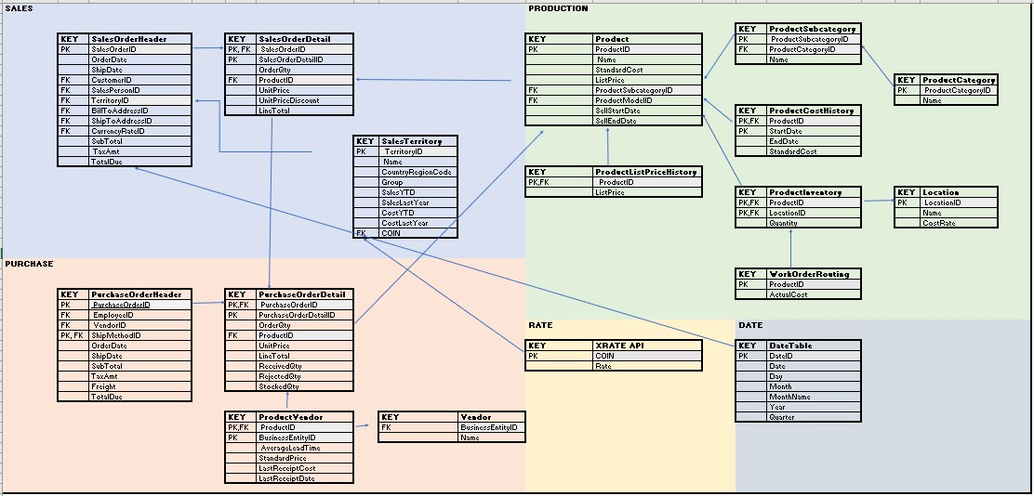
Extract

Slide 9
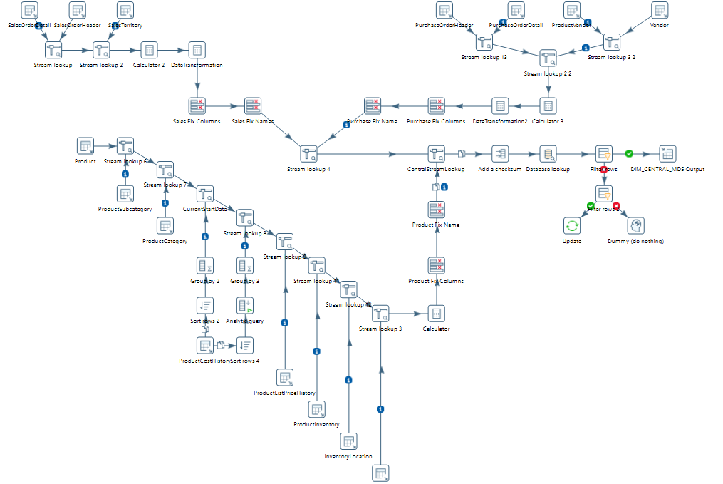
Transform

Slide 10
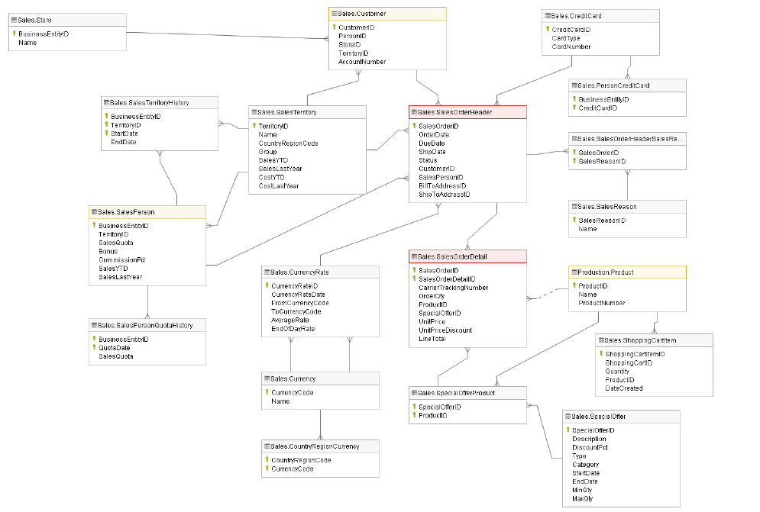
SALES DATASET

Slide 11
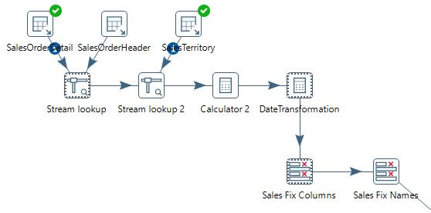
Transformation

Slide 12
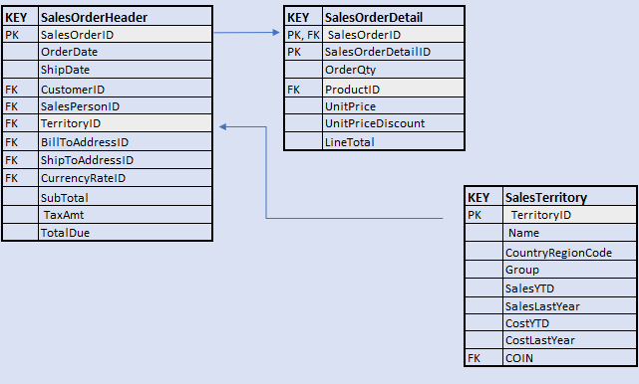
THE RESULT

Slide 13
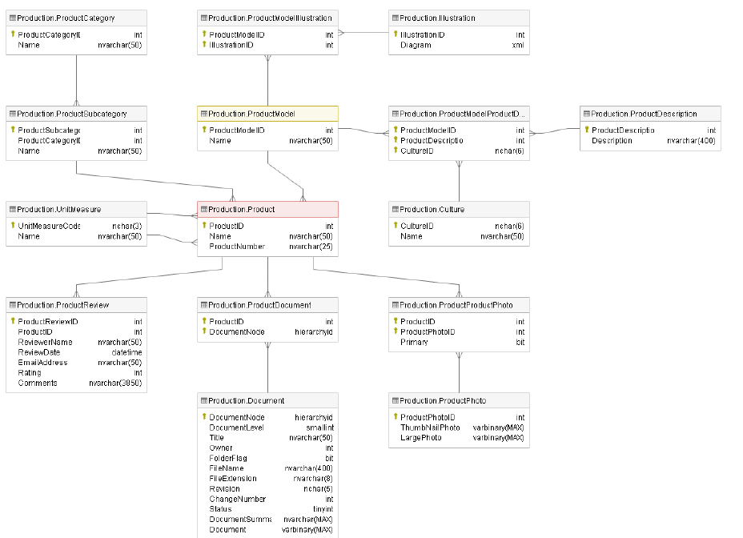
PRODUCTION DATABASE

Slide 14
TRANSFORMATION

Slide 15
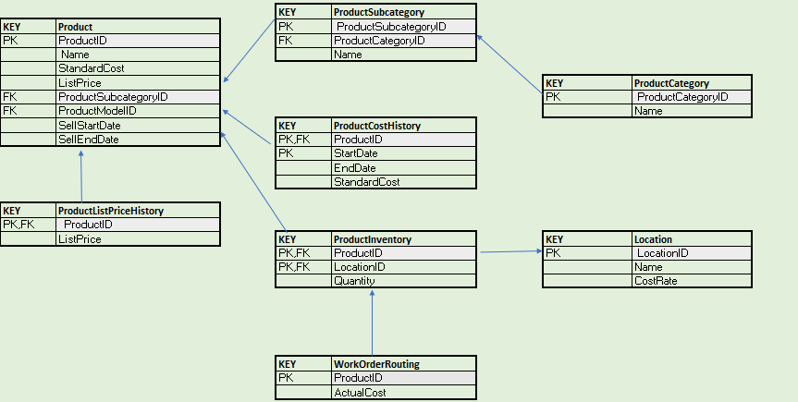
THE RESULT

Slide 16
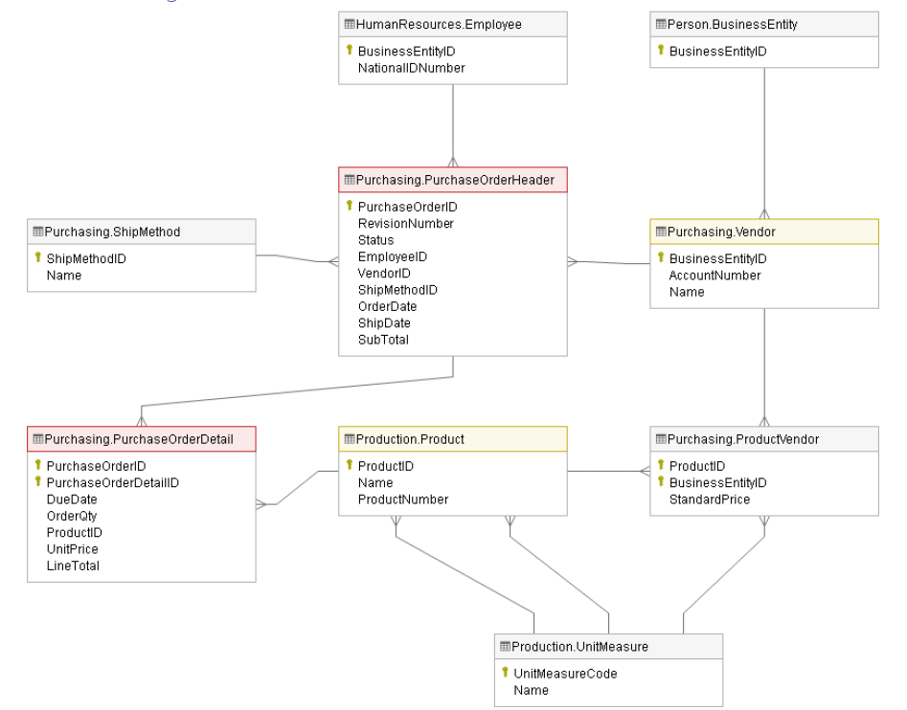
Purchasing DATABASE

Slide 17
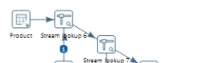
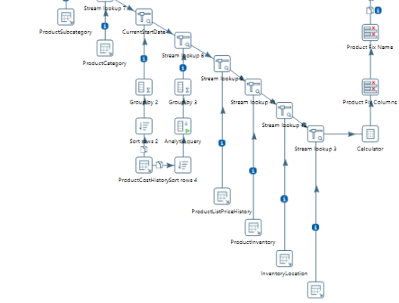
OUR PROCESS

Slide 18
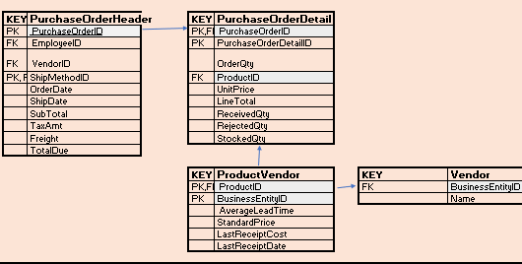
THE RESULT

Slide 19

THE Answers

Slide 20
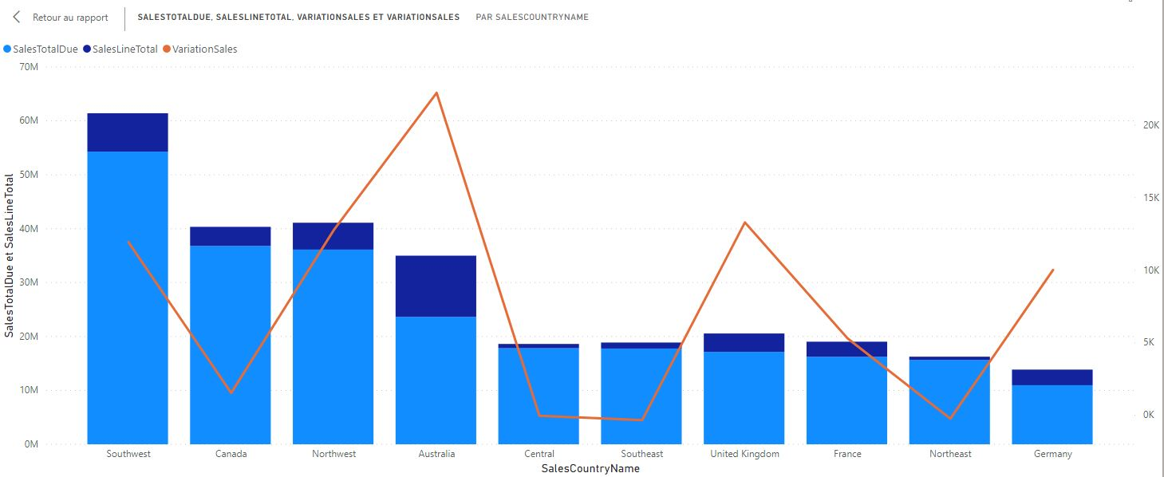
Best/Worst Performing Countries?
Notes:
Total Sales: in US (Southwest) we have the main market. Also we added the amount of promotional sales.
Variation Sales (YoY): we noticed that Australia had the most relevant performance in sales growth YoY.

Slide 21
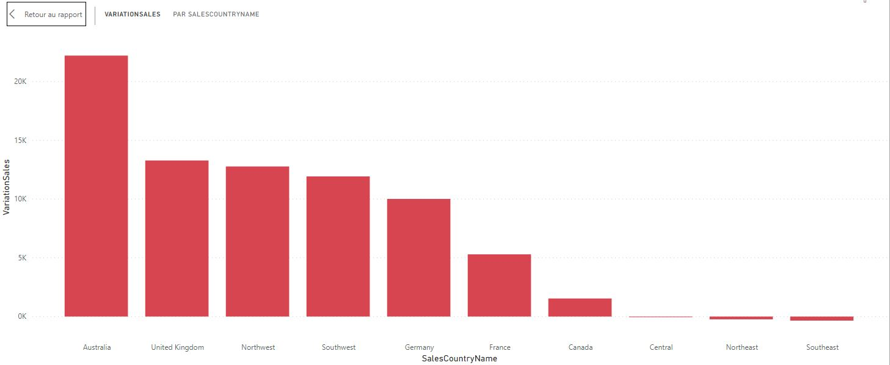
Best/Worst Performing Countries?
Notes:
YoY sales growth ranking.

Slide 22
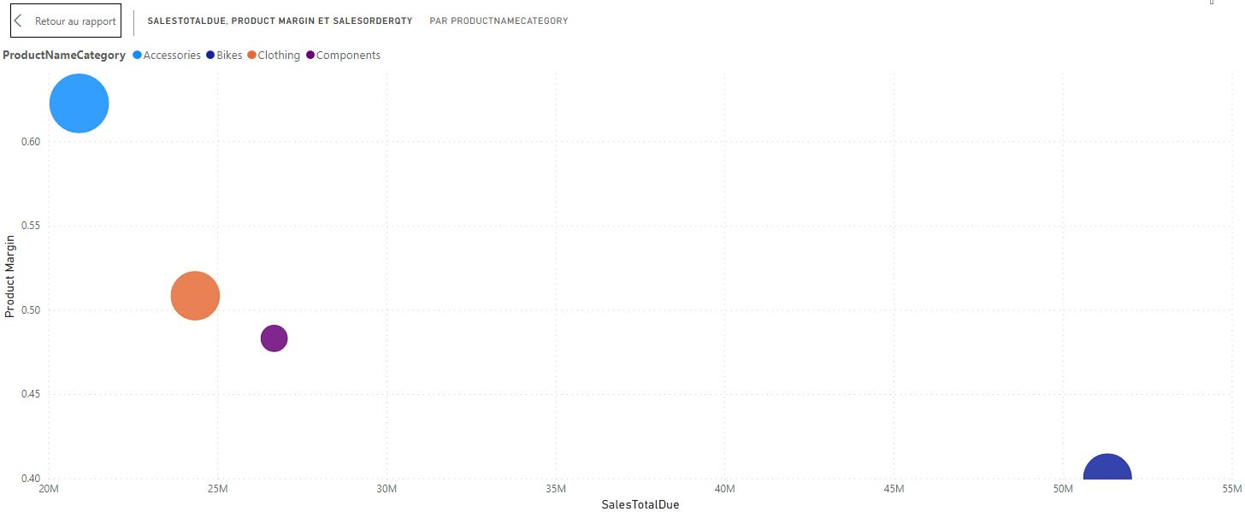
Best/Worst Performing Products?
Notes:
Sales: Per category
Margin: the difference between ProductListPrice and StandardCost
We’ve made a dispersion graph comparing sales and margin. The size of the balls are the sales quantity.
We can notice that although Accessories has the best performance in margin and sales quantity, it has a very low represantation in terms of sales amount. Which means that categories with lower prices are more profitable comparing to categories with higher prices.

Slide 23
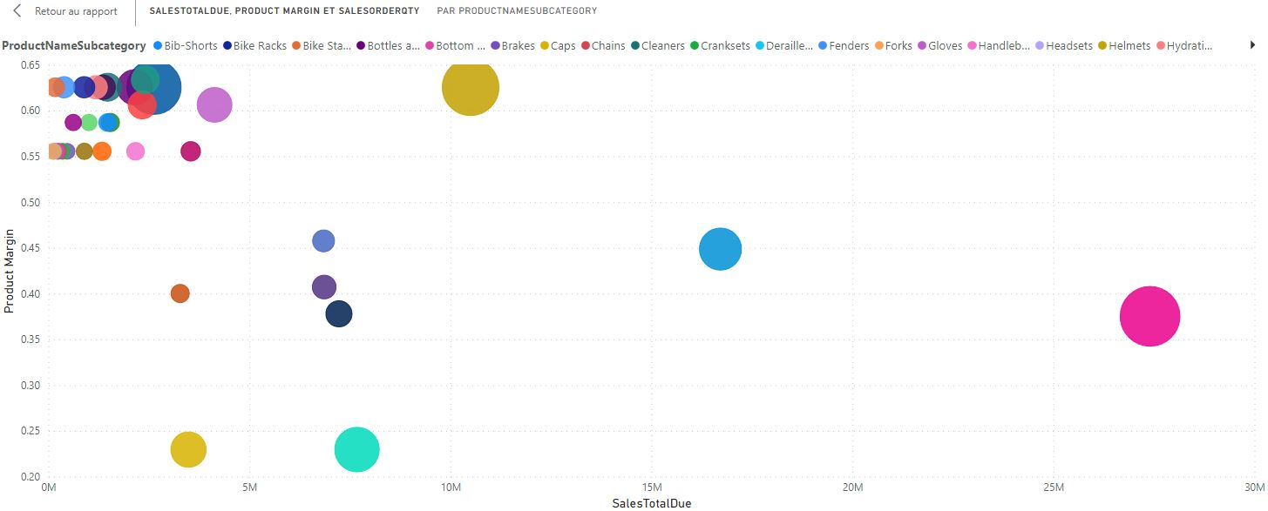
Best/Worst Performing Products?
Notes:
Sales: Per subcategory
Margin: the difference between ProductListPrice and StandardCost
We opened this information per subcategories in order to give top management more details.

Slide 24
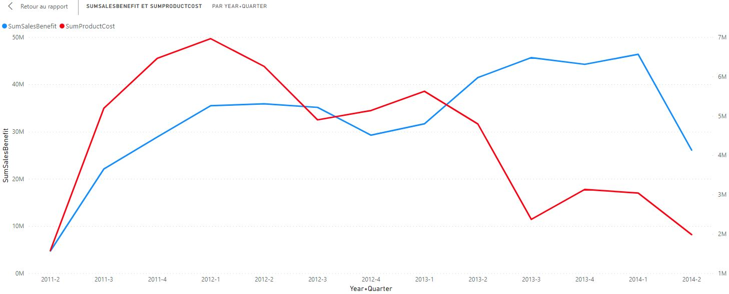
Timeline business performance (Sales and Costs)?
Notes:
We use the date dimension in order to give the timeline vision of sales and production cost. By seen this graph we could notice that during the operation setup we had a high volume of cost and by the time the productivity improved and it is becoming lower quarter after quarter. At the same time, sales trend is increasing. But we see that during the last quarter the sales fall down comparing to the last 3 quarters. We need to do deeper analysis regarding this movement, to see if it could be a seasonality or a sales problem.

Slide 25
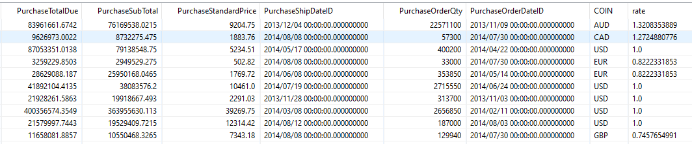
Online perspective of exchange rates
Notes:
The online perspective of Exchange rates can help management to measure in a more accurate way the business performance, mainly regarding to purchasing and pricing management in order to maintain to boost profit margins.

Slide 26
Recommendations
Countries performance: Action plan targeting US Central, Southeast and Northeast, negative growth YoY.
Products performance: Action plan in order to increase sales in Accessories category to boost better profit margins.
Timeline business performance: Deep dive in what happened with sales during the last quarter.
Online perspective exchange rates: implement an automatic pricing process in order to optimize products margin negatively impacted with currencies variations.
Notes:
A suggestion on how finalize the presentation

Slide 27
la pregunta?

